Slide 1
Professional English
Notes:
English for Computer Science

Slide 2
Sentence composition
Subject
Predicate
Object
Objective complete
Notes:
主语，谓语，宾语，宾语补足语，

Slide 3
Appositive同位语
Supplement and explain
Our teacher, Mr. Smith, has developed a kind of new software.
We Chinese are working hard to make our country rich and strong.

Slide 4
Parenthesis
插入语
Make some additional explanations
I think，I hope，I suppose，I guess，you know，don’t you think，it seems，you see，it is said，it is suggested
Her design, I think, is the best of all.
This is the best printer in this company, I suppose.

Slide 5
vocabulary features of computer science English
Vocabulary is the element of a sentence
Vocabulary is the basis of reading, translation and writing.
New terms, concepts, new theories and new products are emerging. with the development of science and technology.
The increase in acronyms is especially rapid, and the technical vocabulary is increasing with the specialized segmentation.
Notes:
新术语、新概念、新理论和新产品不断出现。

Slide 6
Vocabulary classification
technical words
sub-technical words
function words
技术词汇
次技术词汇
功能词

Slide 7
Professional
These words are generally longer and longer, meaning narrower
Bandwidth, flip-flop, superconductivity,
hexadecimal,amplifier,etc.
bandwidth（带宽）
flip-flop（触发器）
superconductivity（超导性），hexadecimal（十六进制）
amplifier（放大器）

Slide 8
These words tend to have different meanings in different majors .
Register
counter, recorder, instruments
in daily life, register, register, the registered letter
寄存器，计数器、记录器，在乐器中表示音区
登记簿、名册、挂号信

Slide 9
Prepositions, conjunctions, articles, pronouns
Sentence structure
The most frequently occurring words of functional words: the, of, in, and, to, is, that, for, are, be
When the recorder is operated in the record mode, previous recordings are automatically erased.
Five function words
当录音机工作在录音模式时，以前的录音被自动擦除。
Notes:
介词、连词、冠词、代词

Slide 10
Word-building of computer science English
The frequency of prefixes and suffixes is very high
compound word “-”
object + oriented → object-oriented 面向对象的
thread + oriented → thread-oriented 面向线程的
point + to + point → point-to-point 点到点

Slide 11
plug + and + play → plug-and-play 即插即用
point+and+click →point-and-click 点击
store-and-forward →store-and-forward 储转发
peer + to + peer → peer-to-peer 对等的
front + user → front-user 前端用户
end + user → end-user 终端用户
push + up → push-up 上拉
pull + down → pull-down 下拉
line + by + line → line-by-line 逐行

Slide 12
paper + free → paper-free 无纸的
jumper + free → jumper-free 无跳线的
user + centric → user-centric 以用户为中心的
wave + length → wave-length 波长
medium + sized → medium-sized 中型的

Slide 13
The constituent parts of a compound word : separated
bus + stop → bus stop 汽车站
machine +building → machine building 机器制造
book + learning → book learning 书本知识
building + material → building material 建筑材料
swimming + pool → swimming pool 游泳池
off + hand → off hand 即刻的
Notes:
合成词的各部分构词成分分开写

Slide 14
independent word
Omit the middle connector of a compound word
in + put → input 输入
out + put → output 输出
feed + back → feedback 反馈
work + shop → workshop 车间
fan + in → fanin 扇入
fan + out → fanout 扇出
out + come → outcome 结果
on + line → online 在线
key+board →keyboard
类似：download upload videotape
Notes:
省略合成词中间的连接符而形成独立单词

Slide 15
Derivative
The three elements of word formation: prefixes, roots, and suffixes
noun affixes such as inter-, sub-, in-, tele-, micro-, etc.
adjectives, affixes, such as im-, un-, etc.
verb affixes such as re-, under-, de-, con-, etc.
Suffixes： -able，-al，-ing，-ed，-meter，-ware，-en
Notes:
派生词

Slide 16
derivative words
（1）multi- 多，多的
multimedia 多媒体 multiprocessor 多处理器
multiprogram 多道程序 multiplex 多路复用
（2）hyper- 超级
hypertext 超文本 hypermedia 超媒体
hyperswitch 超级交换机 hypersonic 超音速的
（3）super- 超级
supertanker 超级油轮 superstate 超级大国
superstructure 上层建筑 superuser 超级用户
（4）tele- 远程的， 电的
telephone 电话 teleconference 远程会议
telescope 望远镜 telegraph 电报

Slide 17
（5）micro- 微型
microprocessor 微处理器 microcode 微代码
microcomputer 微型计算机 microwave 微波
（6）inter- 相互，在 …… 之间
interface 接口 internet 互联网
interlace 隔行扫描 interlock 联锁
（7）re- 再，重新
rerun 重新运行 rewrite 改写
resetup 重新设置 reprint 重新打印
（8）semi- 半
semiconductor半导体 semiautomatic 半自动的
semidiameter 半径 semicircular 半圆的

Slide 18
Borrowed words
Borrowing words refers to the use of words in public English and everyday expressions to express professional meanings.
cache 高速缓存 semaphore 信号量
firewall 防火墙 mailbomb 邮件炸弹
flag 标志，状态
register 寄存器 router 路由器
sector 扇区 package 软件包
Notes:
借用词

Slide 19
Conversion
Convert from one class of expression to another
Nouns to verbs
use 用途 → to use 使用
time 时间 → to time 计时，定时
format 格式 → to format 格式化
program程序→to program 编程
Notes:
转换词

Slide 20
Adjectives to nouns
mineral 矿物的 → mineral 矿物质
good 好的 → good 益处
final 最后的 → final 决赛

Slide 21
Abbreviation
maths——mathematics，ad——advertisement，kilo——kilogram，dir——directory
CAD
CPU
DBMS
BPEL
SOAP
COBOL
SMTP
CAD——Computer Aided Design
CPU——Central Process Unit
DBMS——DataBase Management System
BPEL —— Business Process Execution Language
SOAP —— Simple Object Access Protocol
COBOL——Common Business Oriented Language
SMTP —— Simple Mail Transfer Protocol
Notes:
词汇缩略

Slide 22
Special terminology
TELNET
HTTP：Hypertext Transfer Protocol
SNMP：Simple Network management Protocol
TFTP：Trivial File Transfer Protocol
NFS： Network File System
UDP： User Datagram Protocol
ARP： Address Resolution Protocol

Slide 23
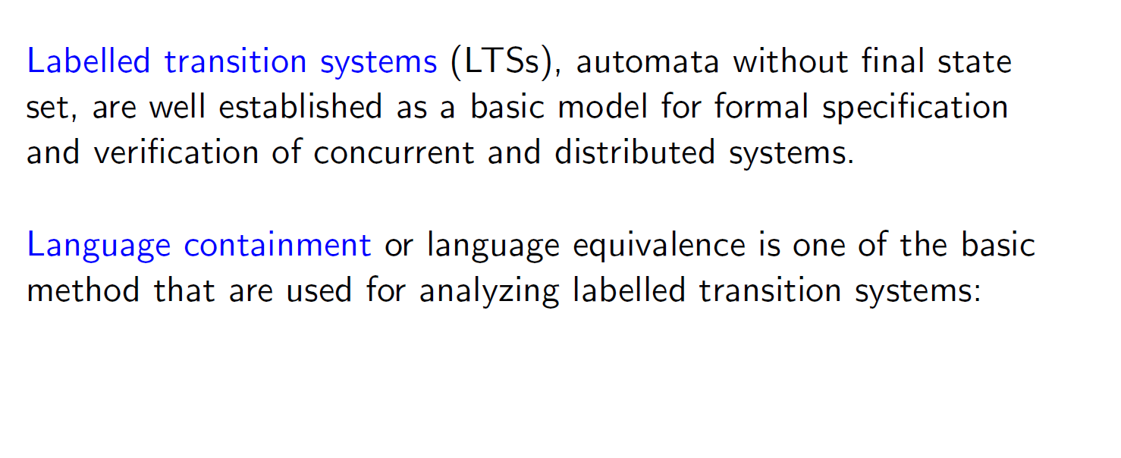
LTS
逻辑理论专家系统
最小截平方和
三烯
LTS labelled transition system

Slide 24
Domain name
cn 中国 ca 加拿大
us 美国 au 澳大利亚
gb 英国（官方） uk 英国（通用）
tw 中国台湾 hk 中国香港
fr 法国 un 联合国
nz 新西兰 dk 丹麦
ch 瑞士 de 德国
jp 日本 sg 新加坡
aq 南极洲 it 意大利

Slide 25
Relational operator
a = b a equals b, a is equal to b,a is b
a ≈ b a is approximately equal to b
a ≠ b a is not equal to b, a is not b
a ≤ b a is less than or equal to b
a ≥ b a is more than or equal to b
a < b a is less than b
a > b a is greater than b

Slide 26
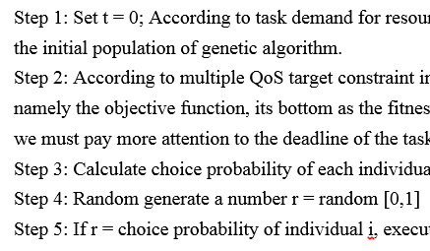

Slide 27

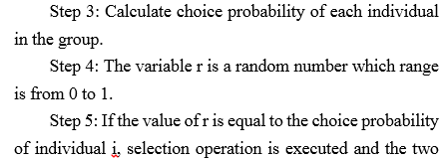

Slide 28
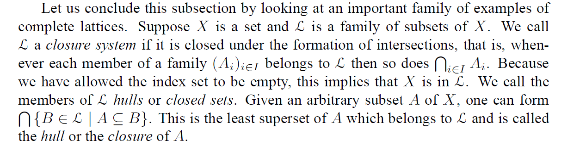
------”Domain Theory” Samson Abramsky and Achim Jung

Slide 29
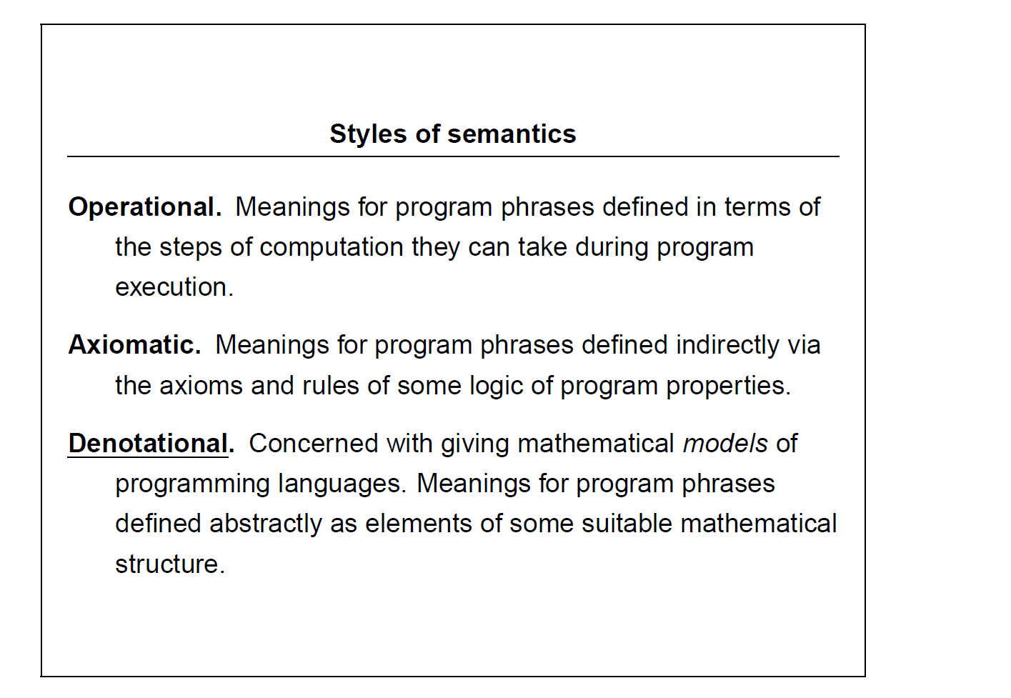
------”Denotational Semantics” Glynn Winskel

Slide 30
Technique
How to understand
How to speak
Question
How to ask
How to answer
How to write
How to talk
How to presentation

Slide 31
We need to understand
How many times are needed to understand one paper?
First: to know the structure
Second: to confirm the keywords
Third: to grasp the idea
Fourth : to understand the detail
Fifth: to read the paragraph, session, chapter, paper, book…

Slide 32
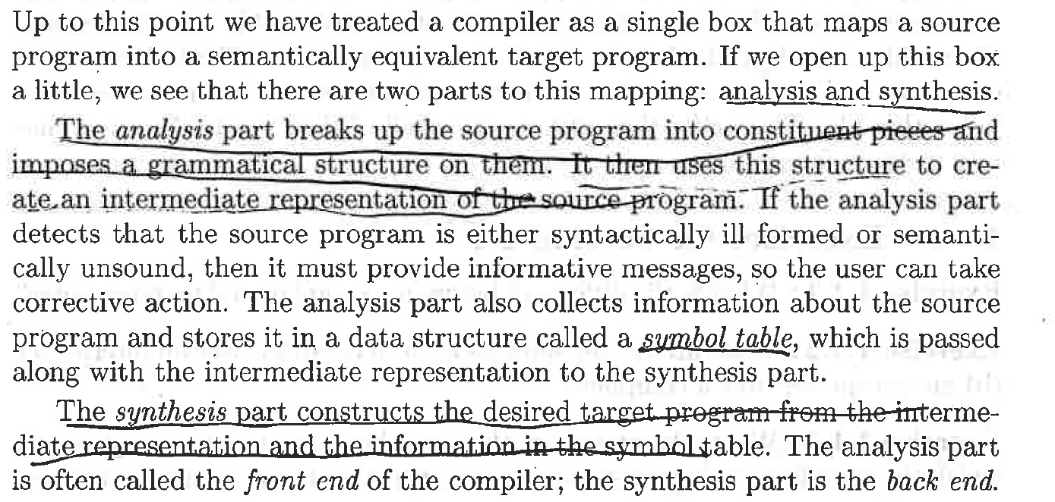
The structure of the paragraph?
(Computer Science)
Simple!
Notes:
Unsound不健全的;不稳固的;
Synthesis 合成
The front end of the compiler

Slide 33
a compiler as a single box that…
If we …., we see that there are two parts…
The analysis part….. The synthesis part…
…called symbol table, which is …

Slide 34
From where are the ideas?
In the first begining sentences!
Upon to this point we have treated a complier as a single box that maps a source program into a semantically equivalent target program.

Slide 35
How to follow the details
This is the idea!!
Simple structure more important!!
The words followed by attributive clause!

Slide 36
Fifth: to read the paragraph, session, chapter, paper, book…
To mark ideas

Slide 37
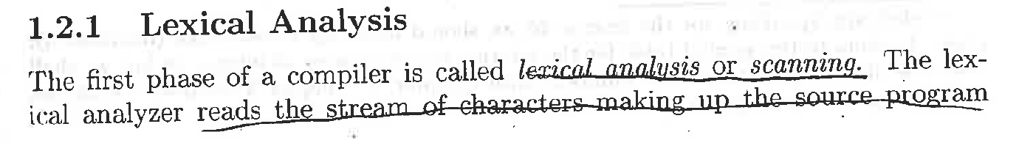
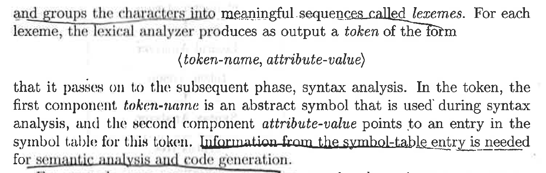
Your case!
Notes:
Lexical analysis or scanning 词汇分析或扫描
Lexemes 词位

Slide 38
Read paths
First: to know the structure
Second: to confirm the keywords
Third: to grasp the idea
Fourth : to understand the detail
Fifth: to read the paragraph, session, chapter, paper, book…

Slide 39
Structures?
.. Is called …
The lexical analyzer reads…
The lexical analyzer produces… the form that is …
the first component token-name is …

Slide 40
Keywords!
The first phase of a compiler is called …
The lexical analyzer reads…
The lexical analyzer produces… the form that is …
The first component token-name is …

Slide 41
Details!
This is the idea!!
Simple structure more important!!
Simple structure more important!!

